Slide 1
Consent, context and community
Jeni Tennison ▪ @JeniT

Slide 2
Consent

Slide 3
Knowledge and awareness of our complex data ecosystem
Availability of alternatives and the consequences of opting out
Consent
Courage to go against social norms and pressures
Obscurity and coercion that constrains our choices

Slide 4
70s scientific research
vs Modern data processing

Slide 5
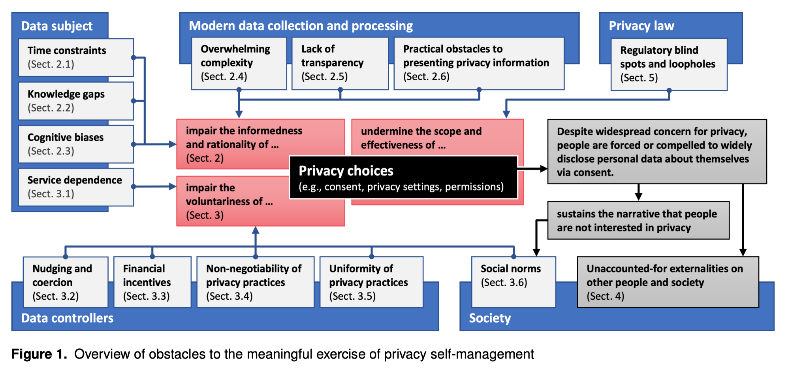
Kröger, Jacob Leon and Lutz, Otto Hans-Martin and Ullrich, Stefan, The Myth of Individual Control: Mapping the Limitations of Privacy Self-management (July 7, 2021). Available at SSRN: https://ssrn.com/abstract=3881776

Slide 6
Privacy paradox?

Slide 7
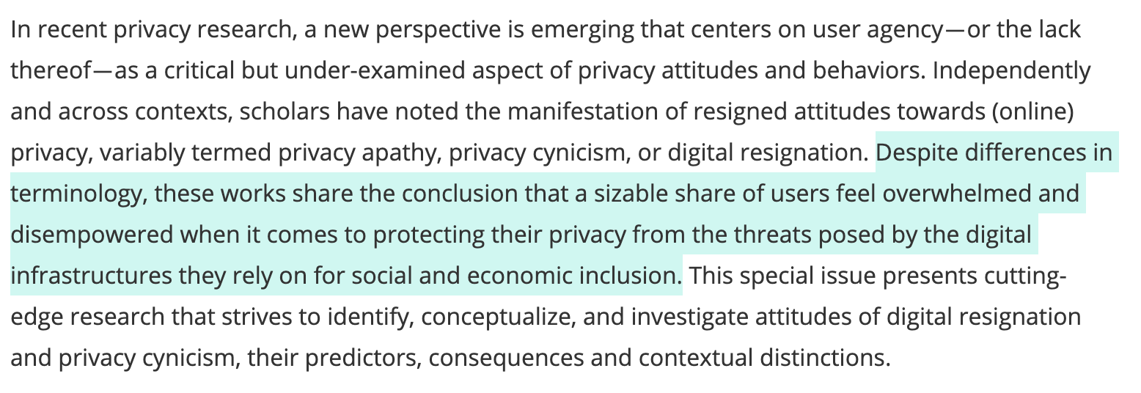
Draper, Nora et al. (2023), Digital Resignation and Privacy Cynicism. Big Data & Society thematic issue, Available at: https://journals.sagepub.com/page/bds/digitalresignationandprivacycynicism

Slide 8
Resignation
Disempowerment
Resentment
Distrust

Slide 9
Power in the world
Power over data and AI

Slide 10
Is there any alternative?

Slide 11
top-down regulation
contextual collective governance
individual consent

Slide 12
Context aware
a sector such as health
a technology such as social media
a local community such as Camden
a professional body such as HR practitioners
a specific school
a particular workplace

Slide 13
Making decisions together
what data is collected
how data is modelled
how data is used
who data is shared with
when data is deleted or archived

Slide 14
Defining choice architectures
what individuals can control
what the defaults are
how options and controls are presented

Slide 15
top-down regulation
inclusive contextual
collective governance
individual consent

Slide 16
Asking (representatives of) your public
customers / clients / local communities
employees
civil society / unions / consumer groups
community leaders / democratic representatives
marginalised / minoritised / vulnerable

Slide 17
Data protection practitioner
+
Decision making facilitator
+
Community voice advocate

Slide 18
OK but how?

Slide 19
This is emerging practice
Notes:
We need to learn this together. I’m going to point you to some examples that I hope will inspire you

Slide 20
Are you ready to share some of your power with the public?
Are you ready to let the public join in your decision making processes?
Are you ready to take the public’s views into account?
Are you ready to support the public to express their views?
Are you ready to listen to the public?

Slide 21
Are you ready to share some of your power with the public?
Are you ready to let the public join in your decision making processes?
Are you ready to take the public’s views into account?
Are you ready to support the public to express their views?
Are you ready to listen to the public?
Read the research
Transparency & monitoring
Staff listen for concerns
Notes:
Tim: Personal experience of raising concerns with social workers re: data governance, but they brushed these off due to lack of training for staff on understanding that people might have different concerns about data governance.

Slide 22
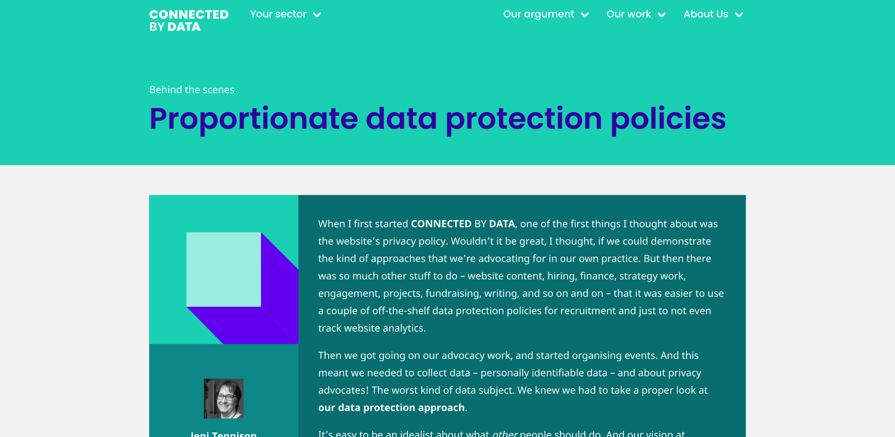
Jeni Tennison (2022), Proportionate data protection policies. Connected by Data. Available at: https://connectedbydata.org/blog/2022/10/21/data-protection-policy

Slide 23
Living with Data (2022), Data matters are human matters: summary of Living With Data findings. https://livingwithdata.org/resources/data-matters-are-human-matters-summary-of-living-with-data-findings/

Slide 24
Are you ready to share some of your power with the public?
Are you ready to let the public join in your decision making processes?
Are you ready to take the public’s views into account?
Are you ready to support the public to express their views?
Create easy access explainers
Ask civil society groups
Commission research
Are you ready to listen to the public?

Slide 25
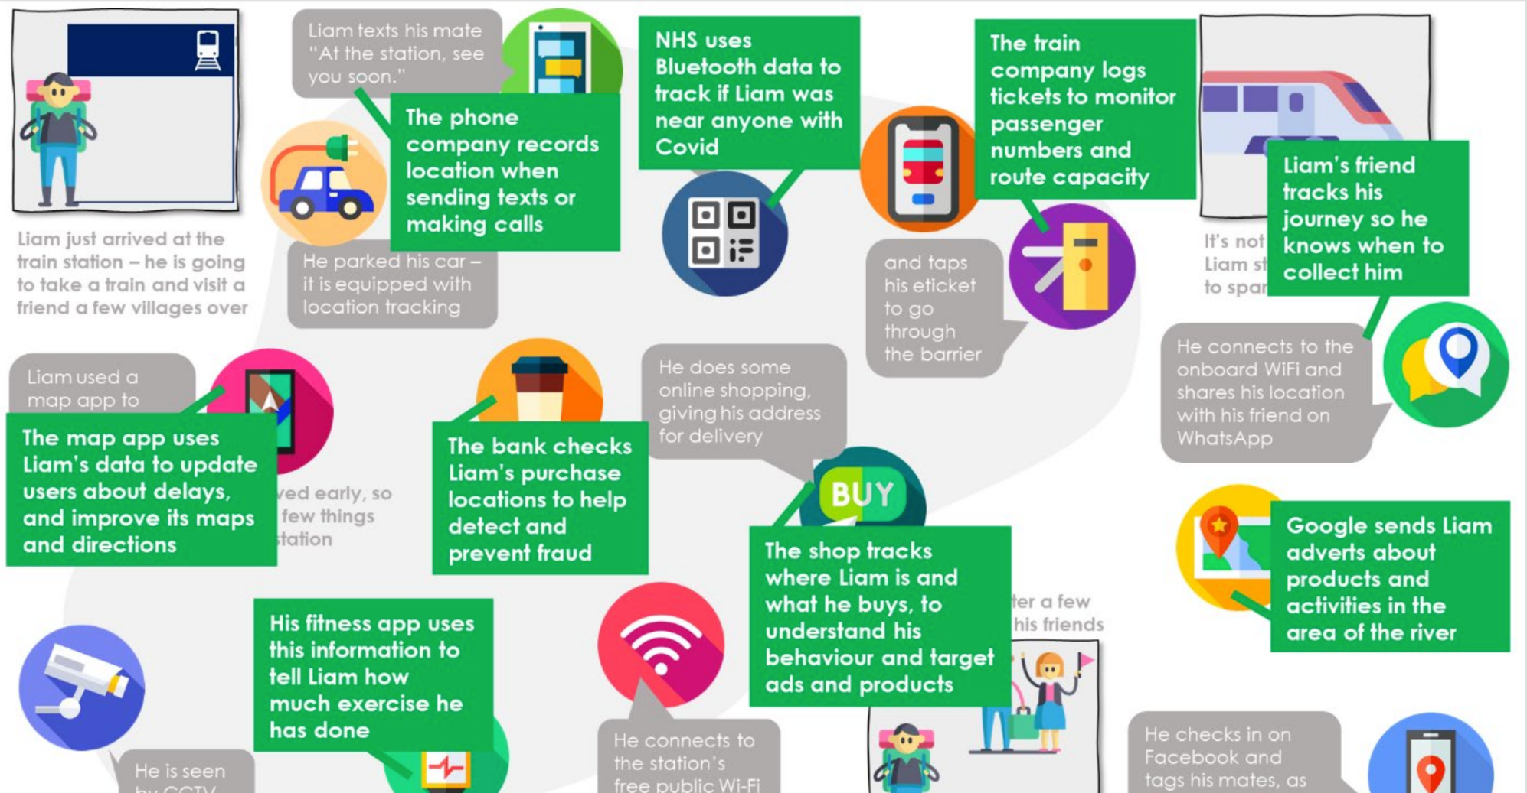
Geospatial Commission (2021), Public dialogue on location data ethics. https://www.gov.uk/government/publications/public-dialogue-on-location-data-ethics

Slide 26
Are you ready to share some of your power with the public?
Are you ready to let the public join in your decision making processes?
Are you ready to take the public’s views into account?
Map stakeholders
Include in DPIA process
Consult public routinely
Are you ready to support the public to express their views?
Are you ready to listen to the public?

Slide 27
Trade Union Congress (TUC), Dignity at Work and the AI Revolution: A TUC Manifesto. https://www.tuc.org.uk/research-analysis/reports/dignity-work-and-ai-revolution

Slide 28
Are you ready to share some of your power with the public?
Co-design principles
Add lay members to boards
Institutionalise public panel
Are you ready to let the public join in your decision making processes?
Are you ready to take the public’s views into account?
Are you ready to support the public to express their views?
Are you ready to listen to the public?

Slide 29
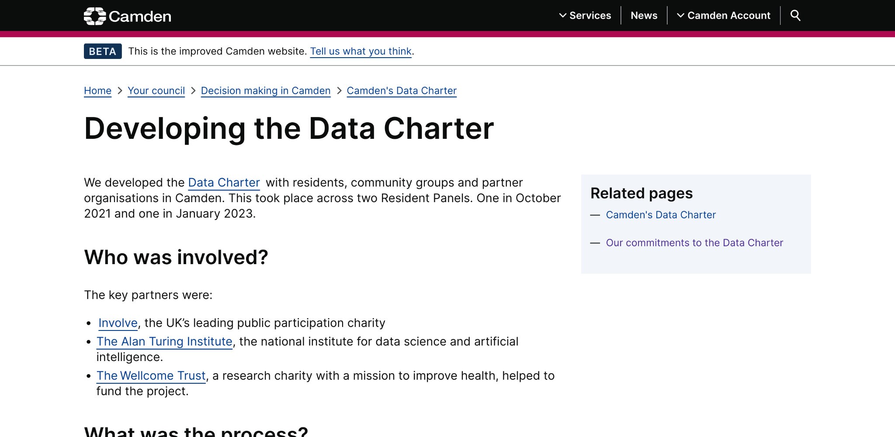
Camden Council (2023), Developing the Data Charter.
Available at: https://www.camden.gov.uk/developing-the-data-charter

Slide 30
OpenSAFELY Digital Critical Friends. https://www.opensafely.org/

Slide 31
Empower public deliberation
Public panel vetos
Independent data stewards
Are you ready to share some of your power with the public?
Are you ready to let the public join in your decision making processes?
Are you ready to take the public’s views into account?
Are you ready to support the public to express their views?
Are you ready to listen to the public?

Slide 32
Open Data Manchester, Developing a Data Cooperative Model for Small Energy Companies. https://github.com/OpenDataManchester/data-cooperatives/blob/main/Data%20Cooperatives%20Report%20FV3G.pdf

Slide 33
Time / cost
Representation / legitimacy
Uncomfortable truths

Slide 34
In summary…

Slide 35
Consent doesn’t fix power dynamics

Slide 36
You can facilitate collective decisions

Slide 37
Don’t let the best be the enemy of the good

Slide 38
Thank you
@JeniT ▪ jeni@connectedbydata.org

